Slide 1
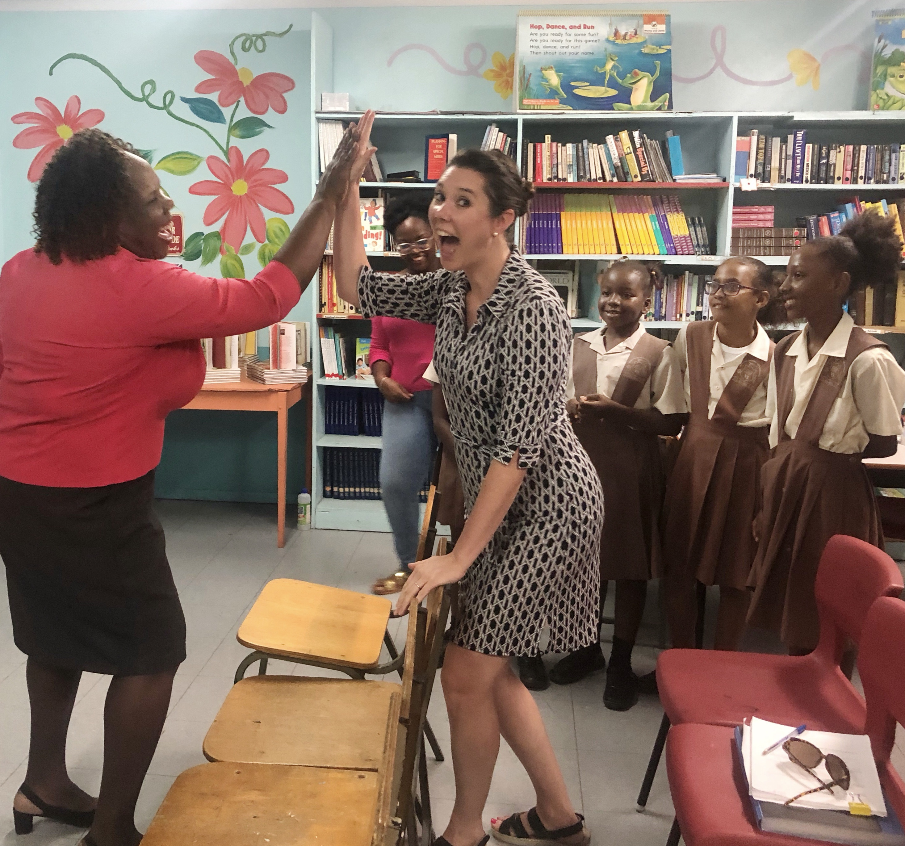
Reading Workshop Ideas to Build a Community of
Lifelong Readers
Notes:
This video is all about reading workshop ideas. What does it look like for you and your students? And how you can make it work to build a community of lifelong readers!

Slide 2


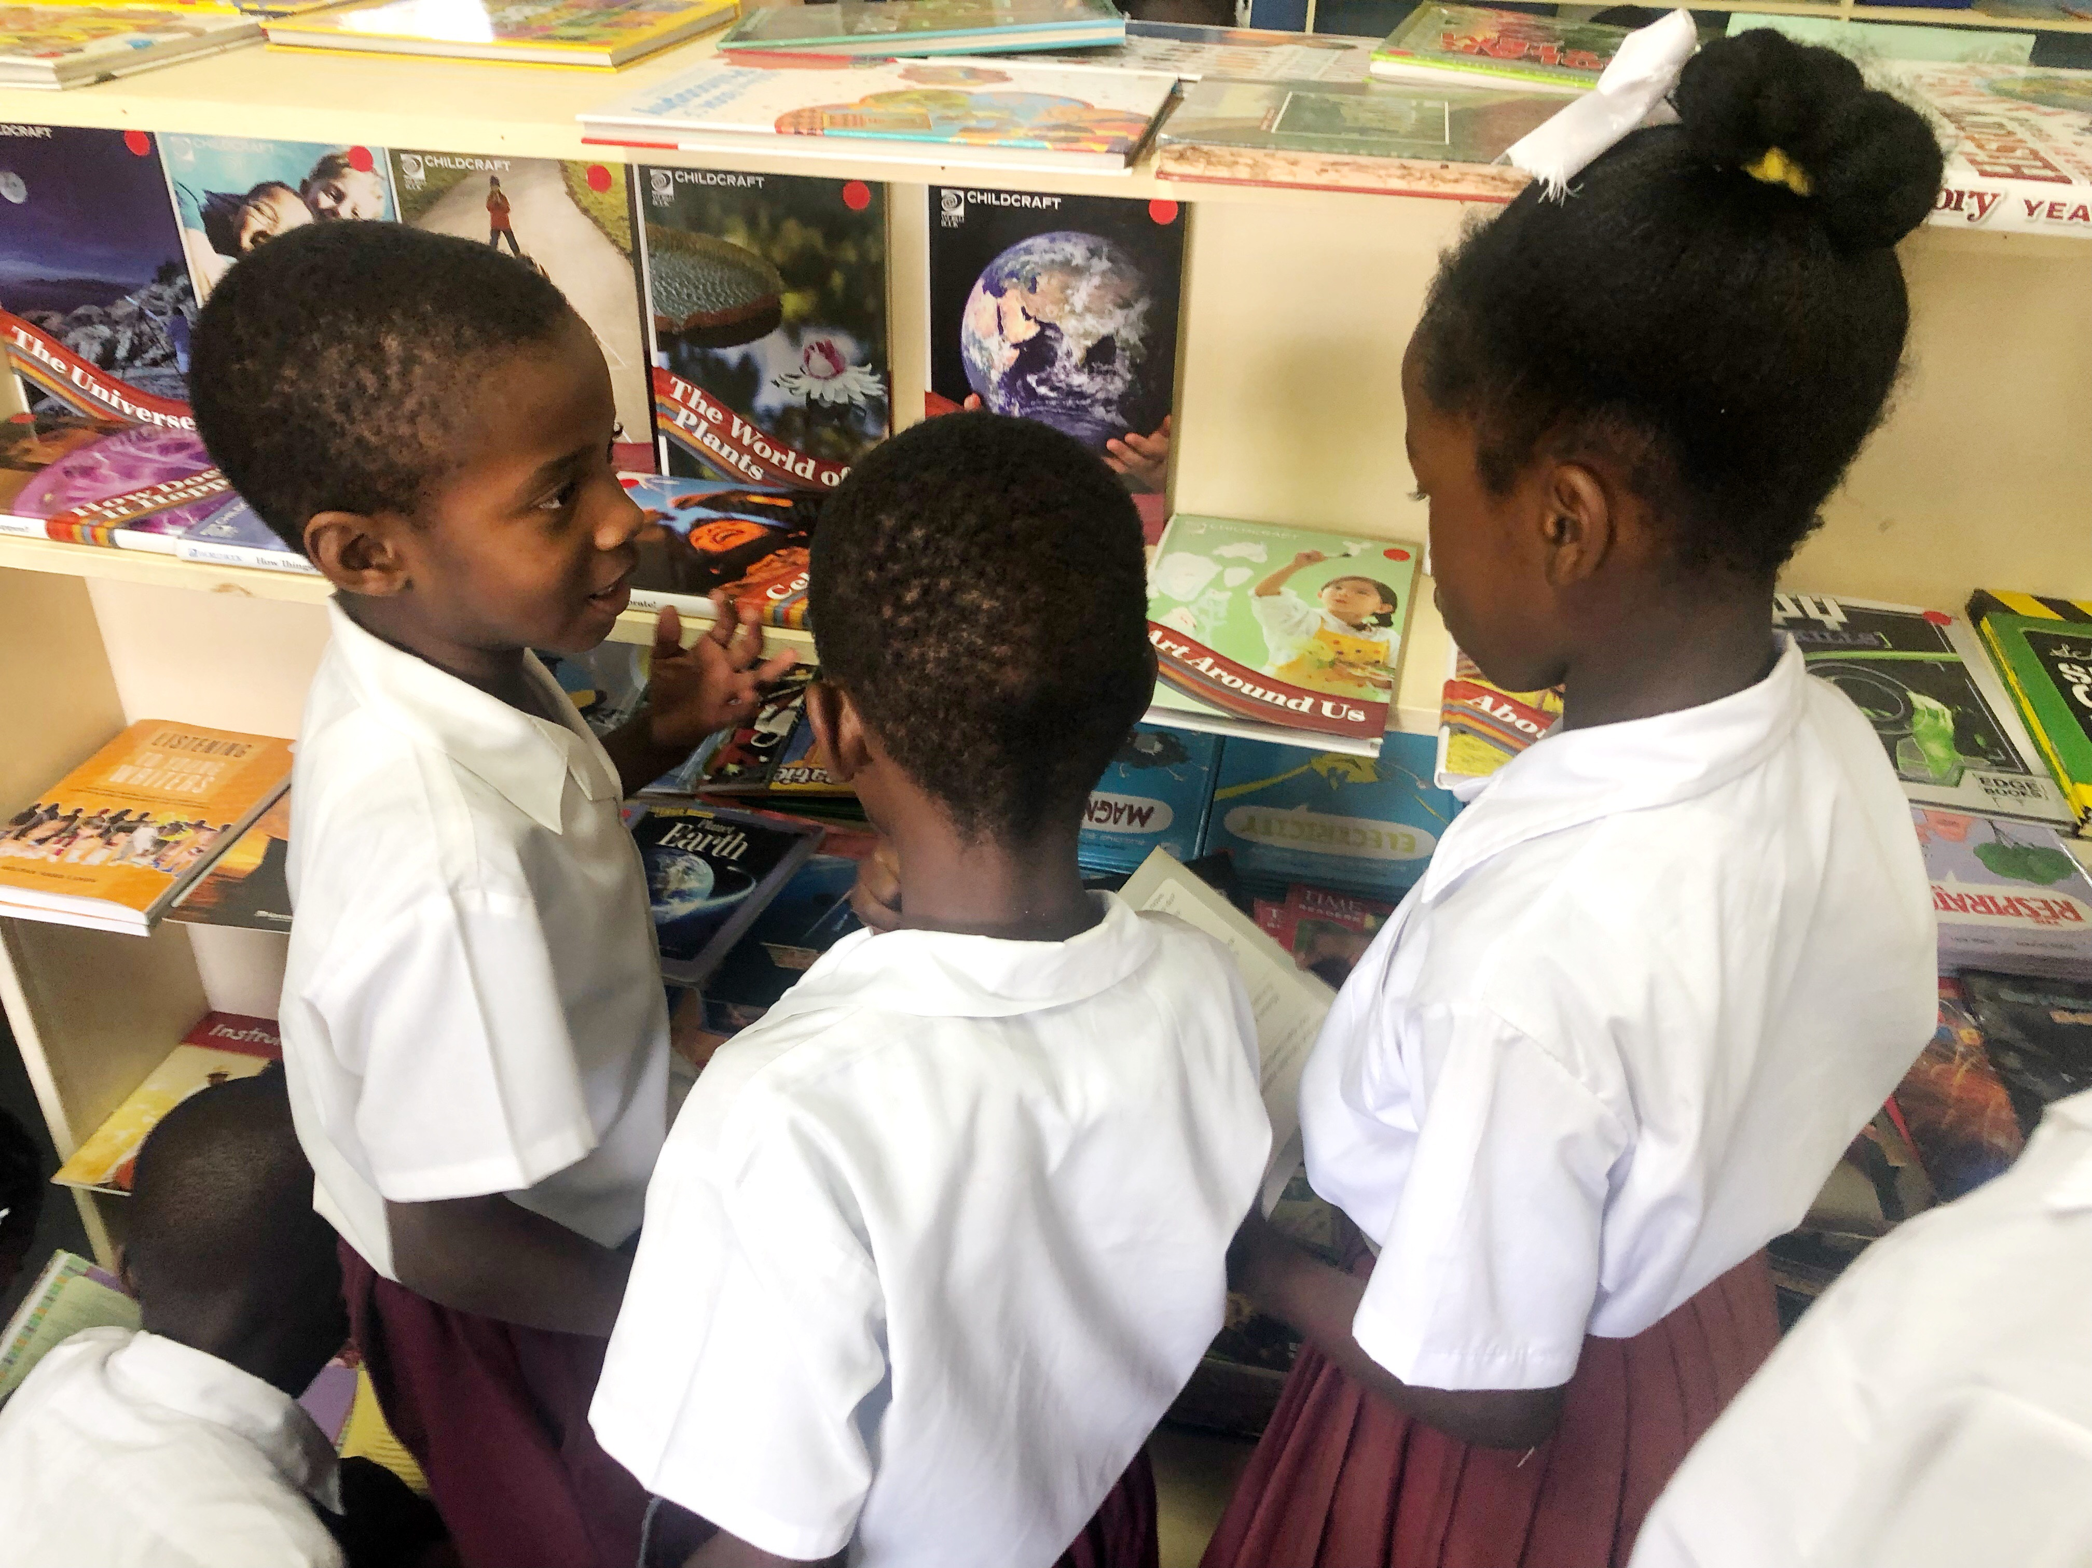
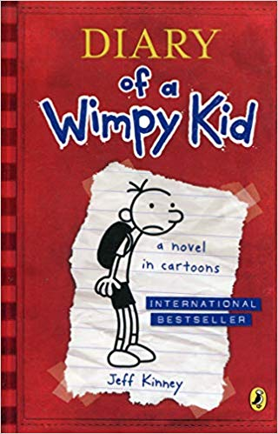

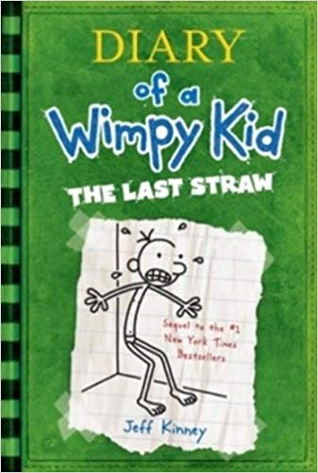
Building a Community of Lifelong Readers
Show preferences for genres, authors, and topics.
Notes:
When students start choosing books for themselves to read on a regular basis like every few days and once a week, they start to become familiar with different series and genres. The begin to know what they LIKE to read and what they want to read more of. For instance, after reading *Diary of a Wimpy Kid, my Grade 4 boys wanted to read: *Diary of a Wimpy Kid: Dog Days, and then *Diary of a Wimpy Kid: The Last Straw. So you see, students get hooked on books that they can relate to, that they enjoy reading, and that they can read with confidence.
You can also encourage students to try different types of books like *biographies to learn more about people in the world and to try nonfiction books about *space, electricity, and inventions.

Slide 3

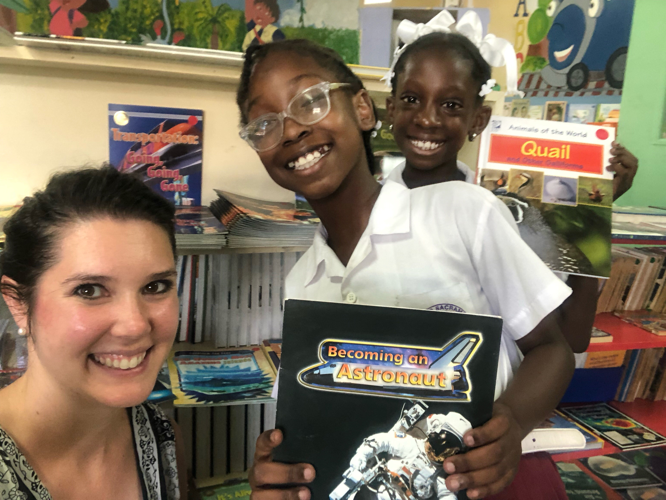
Talk about books and talk about reading!
Notes:
*One of the biggest takeaways when we talk about building a community of readers is the idea that we need to give students the opportunity to talk about books and talk about what they are reading.
We need to create safe environments for our students to be open and honest if they are struggling with a book that they chose. And one way that we can do that is by sharing with them our own personal experiences.
I often share the story of how I tried to read the chapter book *Little Women for the first time in Grade 5, and I hated it. There were so many words, and honestly—I was still building my stamina to read, so the book was really too hard for me. So I abandoned the book and chose an easier one that I was able to enjoy reading. I told myself that I would try Little Women again when I was older. So a few years later in secondary school, I tried to read it again. This time I was 16 and had been reading pretty consistently in the years in between, and the second time I read the book—I loved it! It did not even seem like the same book to me anymore. Share stories like this with your students so that they do not feel ashamed of the reading process.

Slide 4
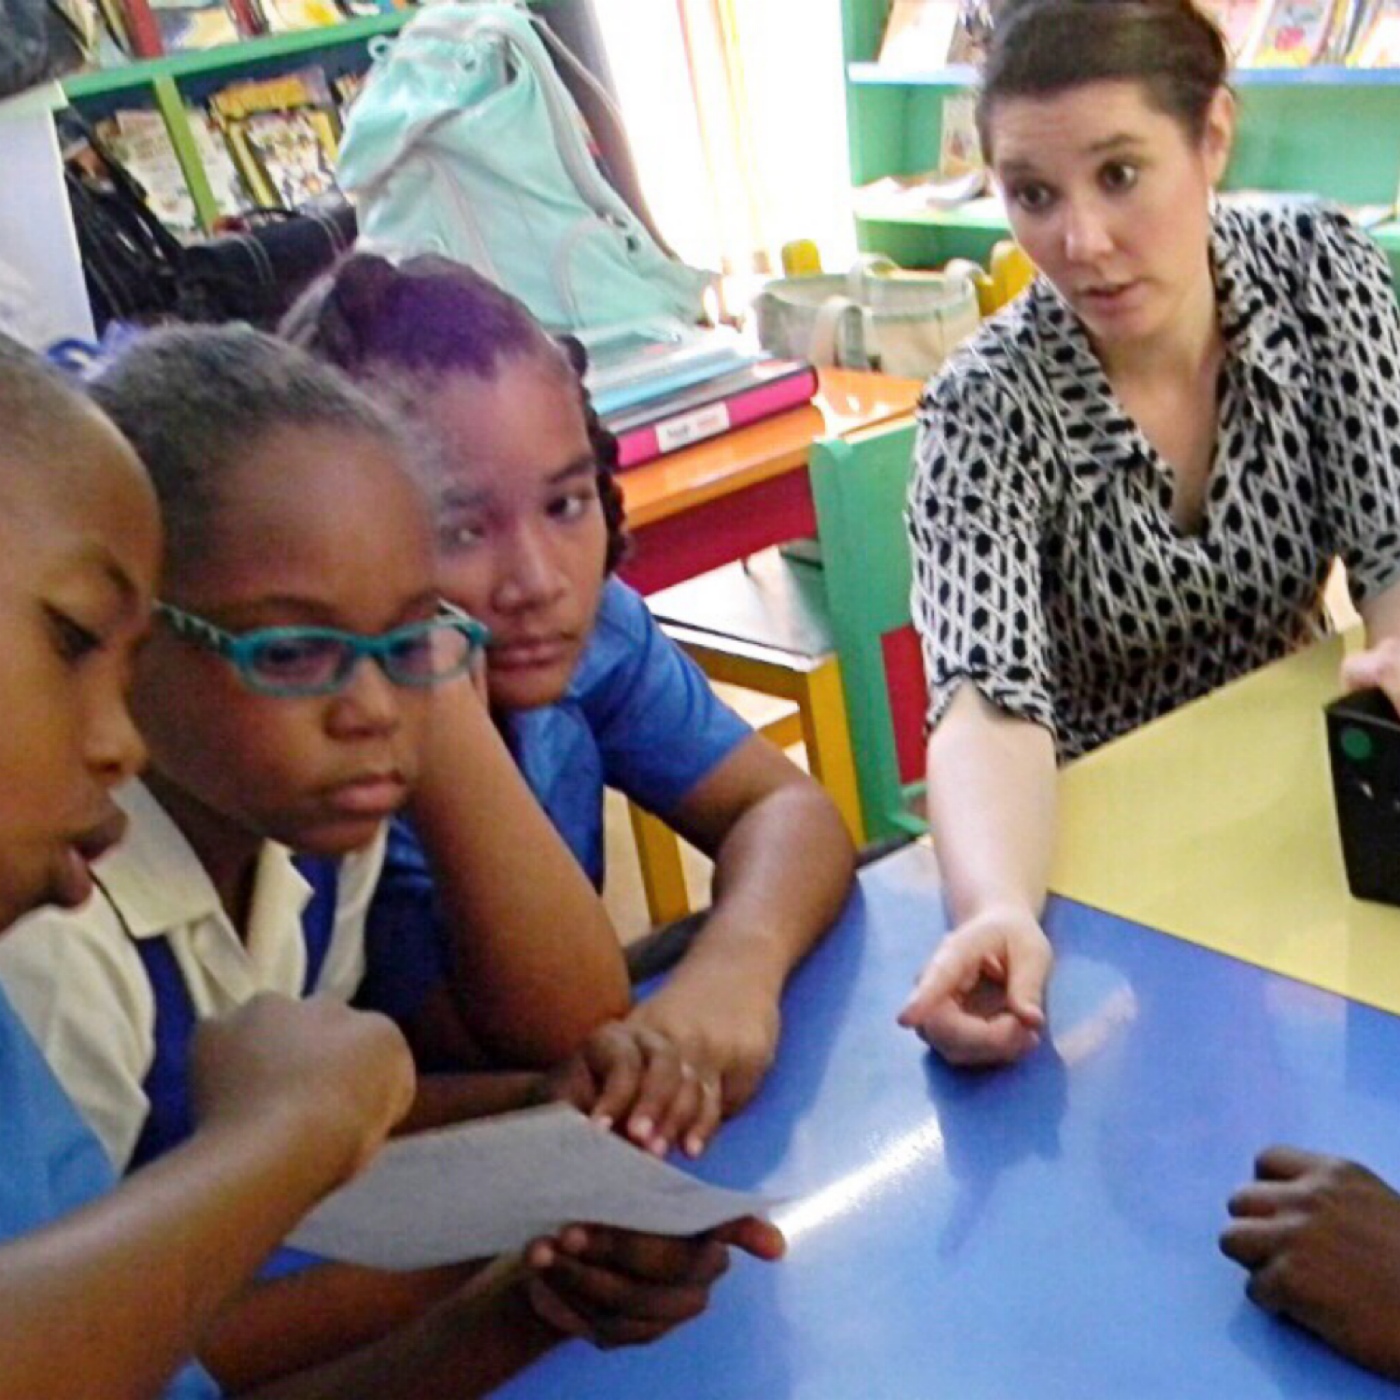
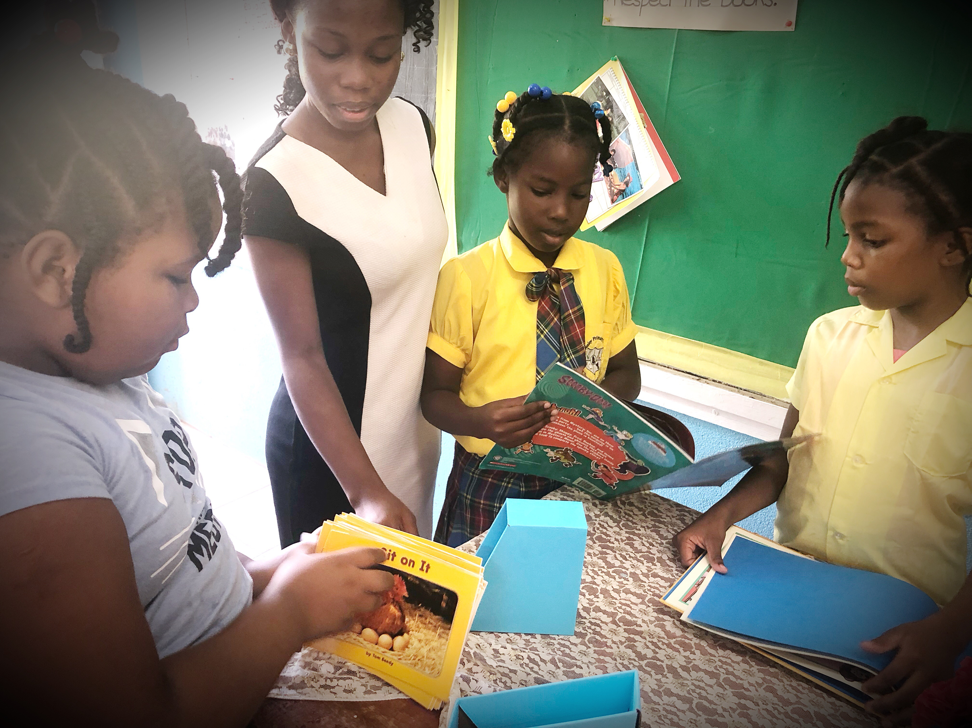
Community of readers talk about books!
Admit that is ok to sometimes abandon a book!
Could you read the same book as one of your students and talk about it?
Could you have a student do a read-aloud (or a page per student) for the class?
Could you give them opportunities in the classroom to talk about books?
Could you have your students write short book commercials and “perform them” for the class?
Notes:
*Admit that is ok to sometimes abandon a book!
*Could you read the same book as one of your students and talk about it?
*Could you have a student do a read-aloud (or a page per student) for the class?
*Could you give them opportunities in the classroom to talk about books?
*Could you have your students write short book commercials and “perform them” for the class?

Slide 5
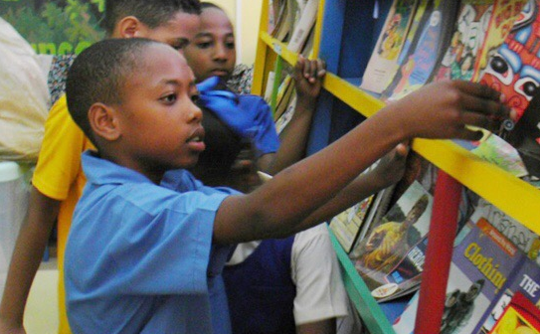

Time + Choice + Accountability
What interests students?
→ CURIOSITY + CONNECTION
What does the student WANT to read?
→ MOTIVATION
Reading plans
Diverse genre
What would happen if we required our students to read 40 books a year?
Notes:
Time and choice are so important. But also accountability.
*What topics interests students? When we can link their curiosity about things with books that have answers to their questions and what they wonder about, students are more likely to connect their learning even more with books. I had a Grade 4 student who loved taking things apart and putting them back together again. This was something he did for fun. But he hated to read. He was not a strong reader. But when I connected him with books about how things work, simple engineering, and books about inventions—his interest in books began to increase. The time he spent in a book increased. I watched as he started to like reading for the very first time in his life. You can do this too! But you have to get to know your students to connect them to the books that will motivate them to read.
Now let’s talk about accountability. We are teachers. We have to have something to SHOW for what these students are reading, right? I get it. So let’s touch briefly about reading plans to encourage students to try different genres and have a way to measure our students’ reading over the course of the year. Donayln Miller in the Book Whisperer is a grade 6 teacher who requires her students to read 40 books in one year. *What would happen if we required our students to do that too? Do you think your student’s reading would improve?

Slide 6
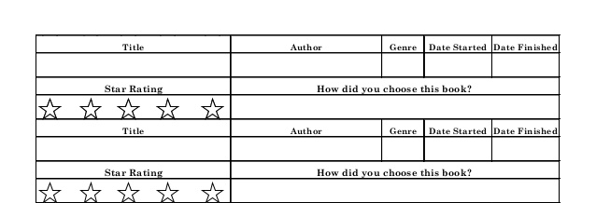
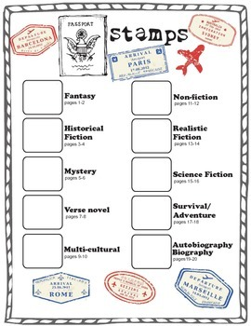
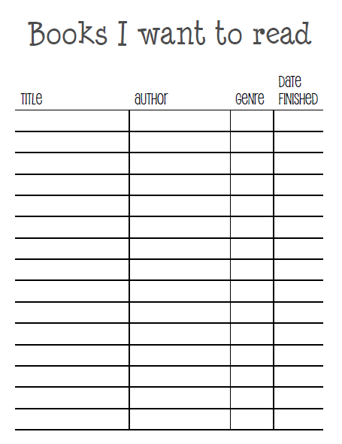
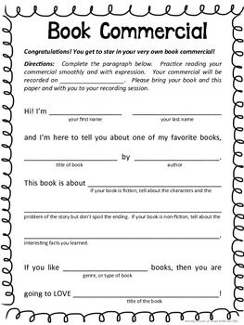
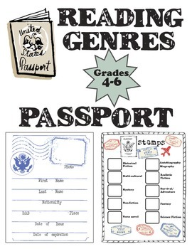
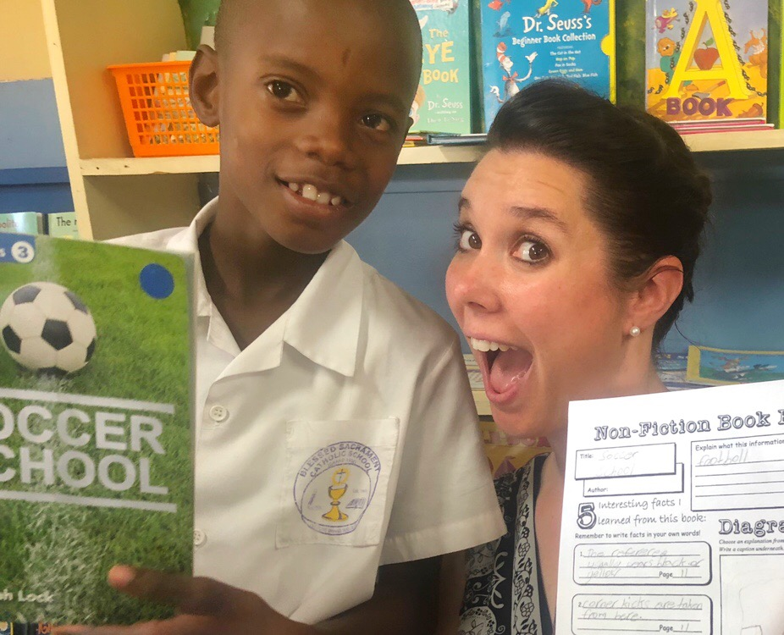
READING + WRITING: How can your students use a Reader’s Notebook?
Reading log (title, author, genre, rating, date).
Genre Passport (variety of genres)
Reading response –commercials
Lists of books we want to read
What else?
Reader’s Notebook
Notes:
*Something I have used with my students that is recommended by many teachers who encourage their students to read what they want to read throughout the course of the school year is a reader’s notebook. This connects the aspects of reading and writing together. Reader’s notebooks can be used with students in Grade K and 1 all the way up to secondary school English class as a way for students to record what they are reading and to write about their thinking while they are reading.
*Reader’s Notebooks can include a reading log, a specific location for students to write the book title, the author, the genre, and then to give it a rating—their opinion whether they liked it or did not like it from 1 to 5 stars. My students LOVED doing this, because it gave them the freedom to read a book and not HAVE to say they liked it. It also gave students a reminder of what they thought of the books they read to recommend them (or not) to their classmates, friends, and even siblings. You could also have a spot where students wrote why they chose to read this book. The Reading Log can also be a place for students to write the date that they finished a book—for some, this is a great accomplishment. Reading Logs make students feel proud as readers and is a reflection of who they are as a reader.
*Another idea to encourage students to read books of various genres is by having students use a *Genre Passport that they glue into their Reader’s Notebook. Something like this holds students accountable to read books that include fantasy, historical fiction, mystery, poetry, nonfiction books about culture or geography or history, nonfiction books about topics of their choice like sports or animals, realistic fiction, science fiction, survival/adventure books, and autobiographies and biographies. This way students are familiarizing themselves with different types of books instead of just reading Geronimo Stilton over and over and over. Keep in mind, those students who love their series books may be resistant to this idea of diversifying their genres, but remind them that they can go right back to reading Geronimo Stilton or whatever other books they love the most after trying a different genre.
*Reading responses don’t always have to be three-page book reports. They can be short journal entries, cartoon drawings with written captions, or they could be *book commercials in which students write and perform a short 2-minute commercial to advertise the book they just read. This was a big hit with my Grade 4 students—and yours will love it too! This get them writing for a purpose. This get them caring about what they are writing, because it’s their responsibility to convince other students in the class to read this book next! So they can’t give the whole thing away!
*Reader’s Notebooks are also a great place to have lists of books that we want to read. I hear about new books I have never read before all the time. Having one list that I can add book titles to is convenient and helpful. When we train our students to begin keeping these lists, they will always have a “next” book to read after finishing the one they are reading now.
*What other ways can we use a simple Reader’s Notebook to keep our students accountable for what they are reading?

Slide 7
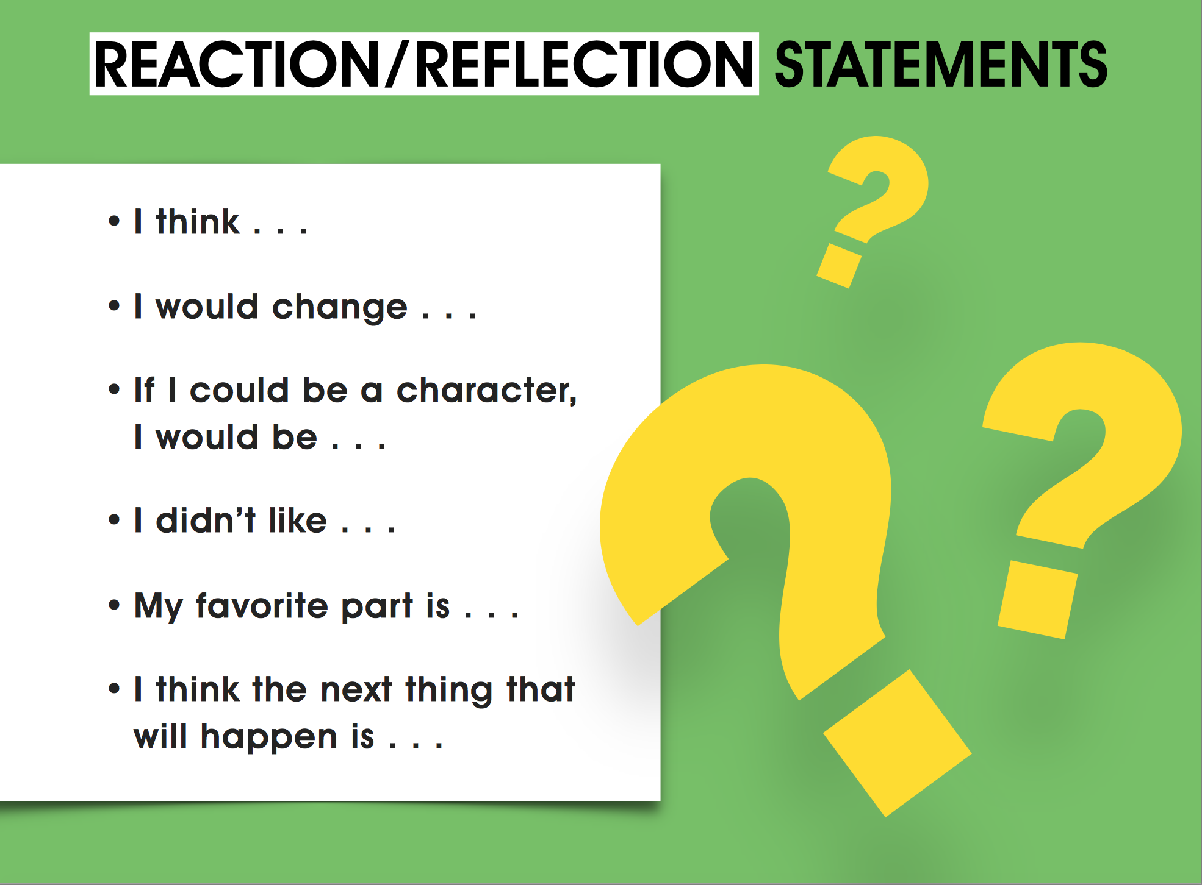
Reader’s
Notebook
Notes:
Having students reading and writing about what they read every day are necessary activities for students to develop the skills they need to be successful in school. Rather than writing full book reports on the books that they read, students can pick a sentence prompt and write a journal entry to respond to these reflection statements instead. They can pick one sentence prompt a day for whatever chapter or book that they read—and win! Win! teachers can keep their students accountable through this measure. Sometimes students have a hard time getting started when they are asked to write, so having these sentence starters ready, will enable students to easily get going.
I think
I would change
If I could be a character I would be
I didn’t like
My favorite part is
I think the next thing that will happen is
Younger students can just finish the sentence. But older ones can develop a short 3-5 sentence paragraph surrounding these ideas.

Slide 8
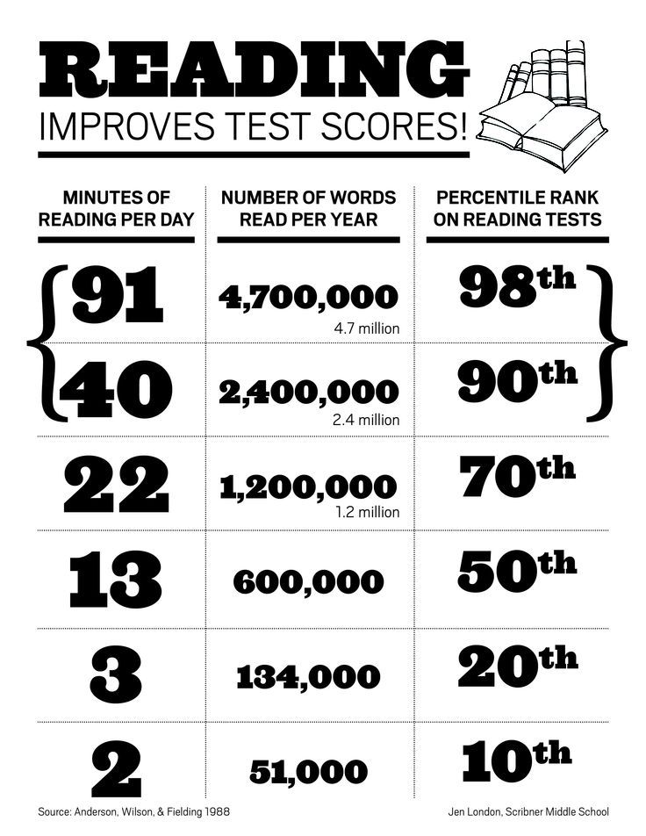
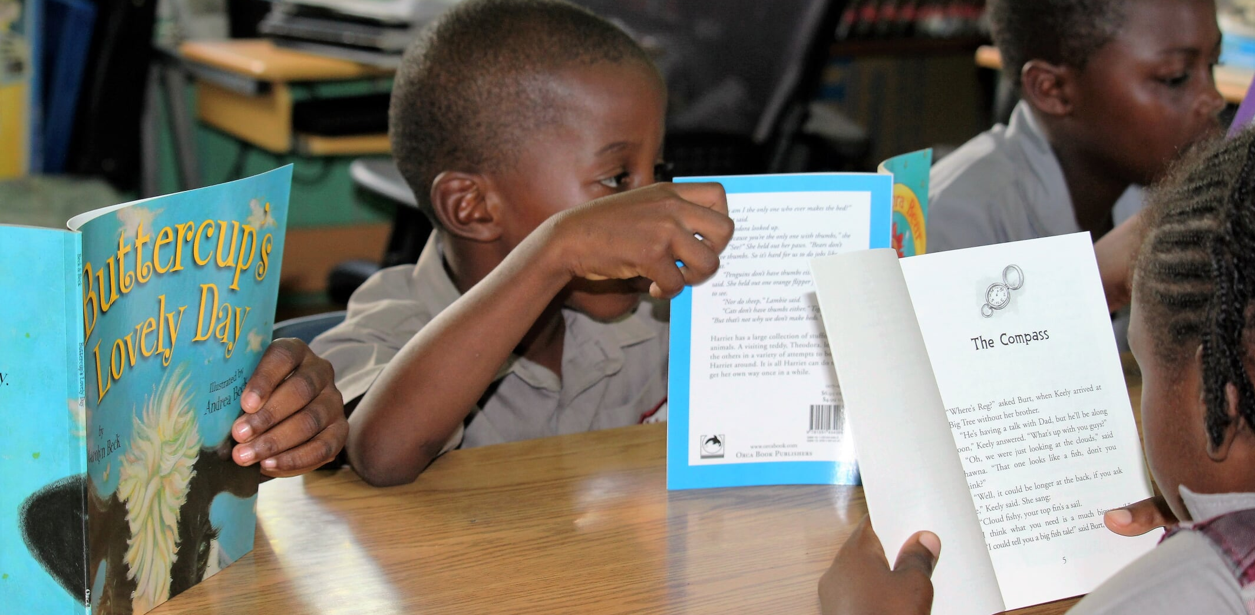
Higher Test Scores – Overall Academic Success
“Research indicates that time spent reading correlates positively with students’ performance on standardized reading tests” (Cunningham & Stanovich, 1998).
Notes:
Remember research indicates that time spent reading correlates positively with students’ performance on standardized reading tests. Students who score in the 98th percentile are reading 91 minutes a day. Students who score in the 90th percentile are reading at least 40 minutes a day. We want our students to score well and read well, so we have to provide them enough time to actually read in school so that they will be motivated to continue reading the same books outside of school too.

Slide 9
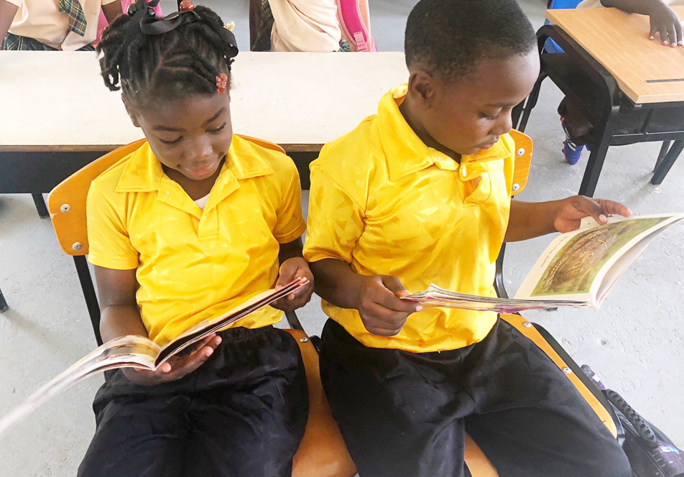
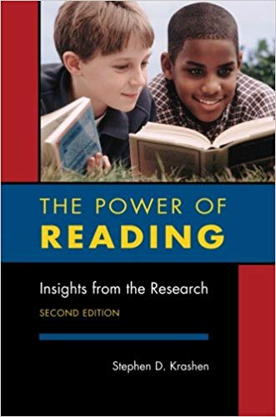
The Power of Reading
“No single literacy activity has a more positive effect on students’ comprehension, vocabulary knowledge, spelling, writing ability, and overall academic achievement than free voluntary reading.” –Dr. Stephen Krashen
Talk and Turn: How can I provide more TIME for free voluntary reading in my classroom and incentivize students to do this at home?
Notes:
When we think about our school day, do we plan in actual time where students get to read the books they check out from the library? Do they get quiet, uninterrupted time in class to read these books and build up the stamina they need to read harder books and to read more often?
Talk and turn to the person sitting next to you and answer this question: How can I provide more time for free voluntary reading in my classroom to incentivize students to do this at home? I will ask you to pause the video and resume it after 2 minutes of discussion with your colleagues.

Slide 10
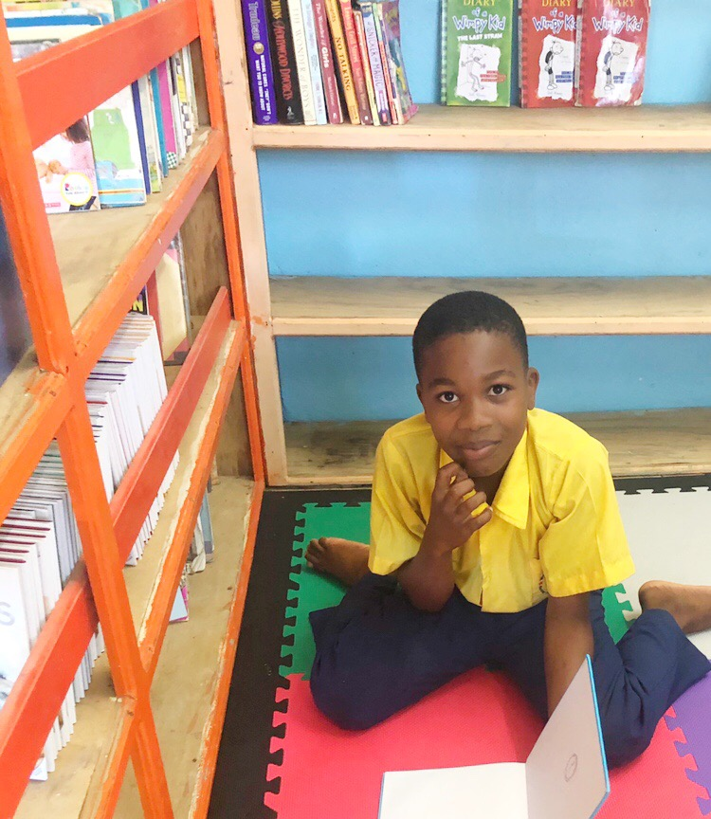
Time for reading is time well spent.
QUESTION: How can we make TIME for free voluntary reading?
ANSWER: Protect part of your Language Arts block for free independent reading
Notes:
Time for reading is time well spent. We as teachers can protect part of our Language Arts block for this reading to take place. Start thinking about how you can make that happen every day, so students know that they will have at least 15 minutes a day to read what they want to read and get in the daily habit of it.

Slide 11

Reading Workshop
Time
Choice
Response
Community
Structure
Notes:
Have you considered how you use your Language Block time? What is preventing you from carving out the time to allow students to actually read in the classroom. Consider the five elements of a reading workshop outlined by Donalyn Miller in a book I recommend called The Book Whisperer.
1. Time: Students need substantial time to read and look through books.
2. Choice: Students need the opportunity to choose reading material for themselves.
3. Response: Students should respond in natural ways to books they are reading through conferences, written entries, classroom discussions, and projects.
4. Community: Students are part of a classroom reading community in which all members can make meaningful contributions to the learning of the group.
5. Structure: The workshop rests on a structure or routines and procedures that supports students and teachers.

Slide 12

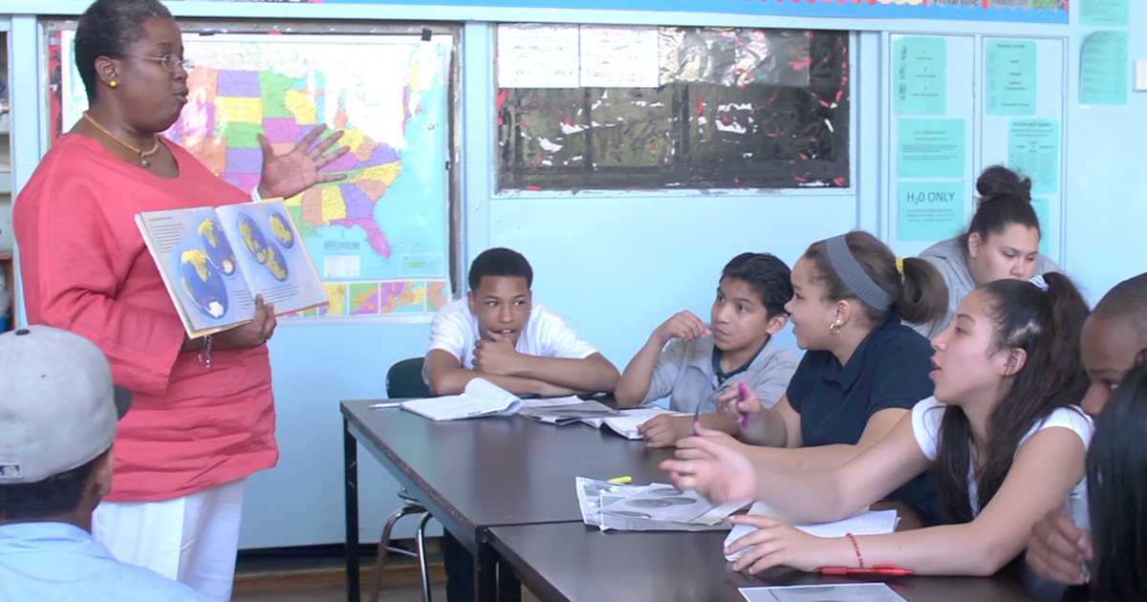


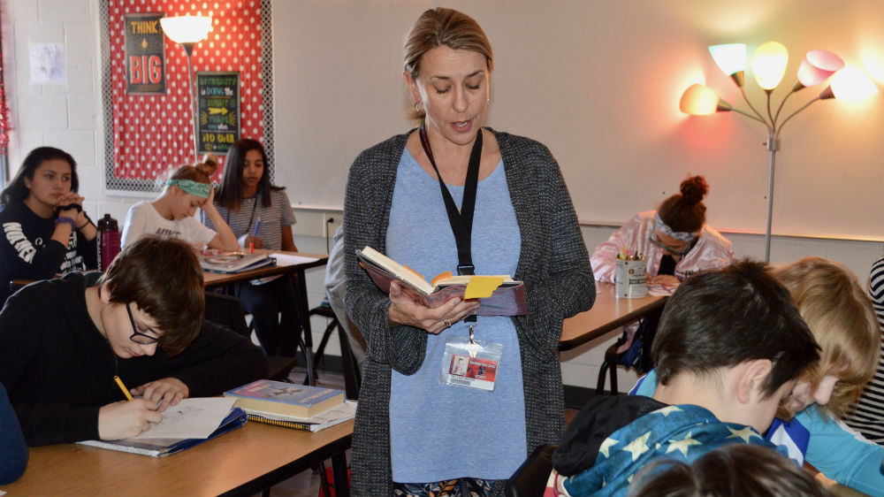



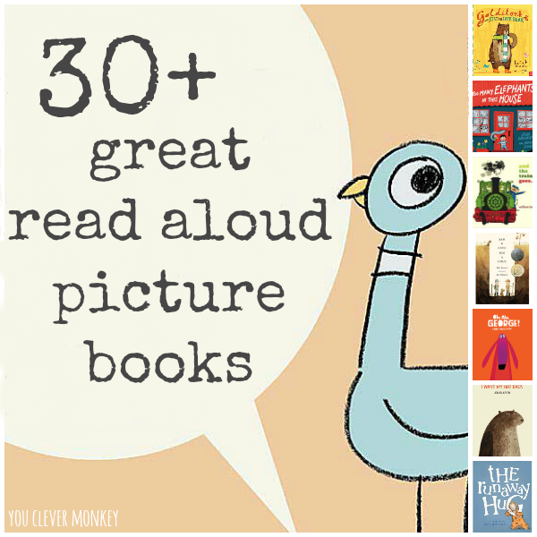

How to STRUCTURE a Language Block--
Activity | Description | Time
Mini Lesson | Direct instruction on reading or writing strategy. Model through read-aloud book. Practice + discussion through an engaging read-aloud book. | 25% (or less)
Free, independent reading | Students are reading their choice of book and responding to the prompt of their choice in a Reader’s Notebook. Teacher checks in with a few students a day individually about what they are reading through a Reader’s Notebook. | 50% (or more)
Reading Clubs | Students discuss in small groups (3-5 students) what they are reading and have the opportunity to share their written reactions in a Reader’s Notebook. | 25% (or less)
Notes:
Here’s the way I have structured my Language Blocks in the past with my Grade 4 classes and my Grade 6 classes. I start with a mini lesson. *This is the direct instruction time. Unfortunately, this is what often consumes most of our Language Blocks RIGHT now (and believe me, I was guilty of this for YEARS until I realized how detrimental it was to the reading growth of my students)—*Direct instruction is when we are standing in front of the class teaching, they are sitting there watching us, but they’re not reading their books during this time.
*Now, don’t get me wrong—direct instruction is extremely important. This is the time for us to explain and our time to model how to apply skills we want our students to learn. *But we need to be mindful that this portion of our Language Block should only be taking—at the most—25% of the time or less. *So if you have an hour language block, we are talking about a 15 minute lesson. For me, I was required a 2 hour block. So my lessons were 30 minutes or less—always. And to keep my students accountable and help them know that the “lecture time” was coming to an end so they would get to read their books—which they area always so happy about—I would actually set a *timer on my phone for myself and place it on a responsible student’s desk to help me stay within the time frame I had set.
*My direct instruction on a reading or writing strategy was straightforward, short, and simple. If it needed to be elaborate and lengthy—like how to write an essay, I would chunk the lesson into parts and teach one manageable part a day within the 15 or 30 minutes. *Modeling is also part of direct instruction and this is so important for our students too. *Modeling to the students through a read-aloud book is a way to show our not only what they are expected to do but also see how they can apply their skills to an actual book and to reading.
*And yes, I read books aloud to my Grade 6 students—even though they were no longer kindergarteners. *For instance I could show students how to write an essay about a picture book in order to model the skills I want them to apply to a higher-level chapter book. *Older students love it when I incorporate a picture book to model something, because all students enjoy listening. *It is a time for them to focus their attention on the THINKING part of the reading rather than the sounding out of words and the actual READING part of the process.

Slide 13


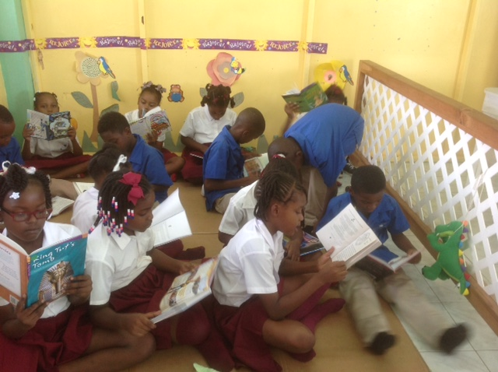
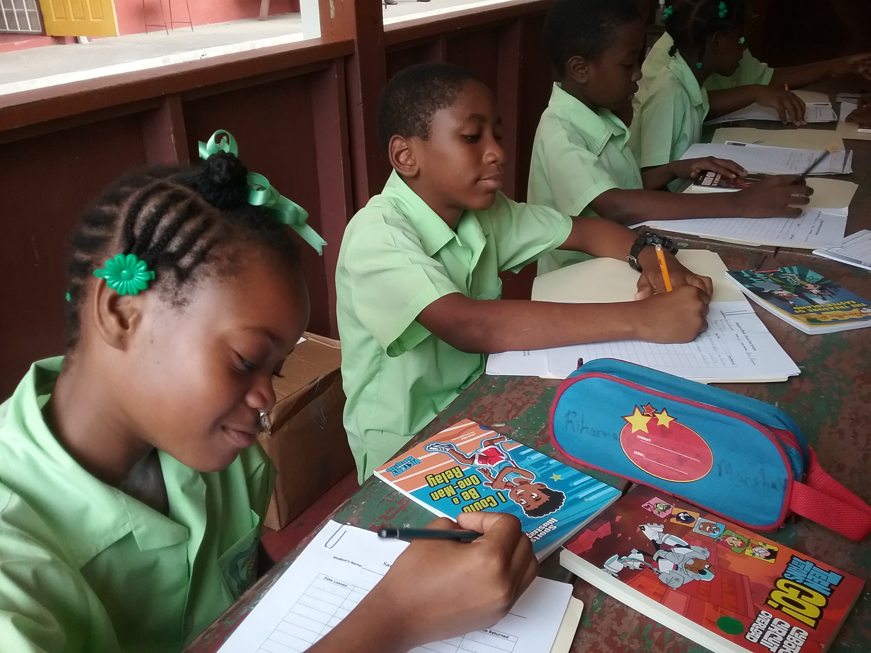
How to STRUCTURE a Language Block--
Activity | Description | Time
Mini Lesson | Direct instruction on reading or writing strategy. Model through read-aloud book. Practice + discussion through an engaging read-aloud book. | 25% (or less)
Free, independent reading | Students are reading their choice of book and responding to the prompt of their choice in a Reader’s Notebook. Teacher checks in with a few students a day individually about what they are reading through a Reader’s Notebook. | 50% (or more)
Reading Clubs | Students discuss in small groups (3-5 students) what they are reading and have the opportunity to share their written reactions in a Reader’s Notebook. | 25% (or less)
Notes:
Free, independent reading is 50% or more of the Language Block. This is when the magic happens. *This is when students are reading their choice of book and really getting into it. *This is when students are responding to the prompt in their Reader’s Notebook that we talked about.
*For younger grades this is when you are reading one on one with students and reading in small groups depending on reading levels. For older grades, this is time when you can be checking in with individual students and having short, quiet conferences together over by your desk while the rest of the class is reading. *You can talk with the student about the book he or she is reading and what they are writing about it in their Reader’s Notebook. You can have the student show you what he or she wrote in his or her notebook and use that as a springboard for discussion. Keep in mind, the rest of the class is not held up by this individual conversation going on. The class is getting their reading minutes in while this is happening. Students know that they need to be writing good sentences and keeping up with their reading, because they know these individual conferences will be taking place. So they expect it and are ready.

Slide 14
How to STRUCTURE a Language Block—
Activity | Description | Time
Mini Lesson | Direct instruction on reading or writing strategy. Model through read-aloud book. Practice + discussion through an engaging read-aloud book. | 25% (or less)
Free, independent reading | Students are reading their choice of book and responding to the prompt of their choice in a Reader’s Notebook. Teacher checks in with a few students a day individually about what they are reading through a Reader’s Notebook. | 50% (or more)
Reading Clubs | Students discuss in small groups (3-5 students) what they are reading and have the opportunity to share their written reactions from their Reader’s Notebooks. | 25% (or less)
Notes:
*Finally, I recommend the last 25% of the Language Arts class is set aside for *reading clubs. This is a time when students get to talk about books—which is vital for reading communities. This is when students discuss in small groups (3-5 students) what they are reading and have the opportunity to share their written reactions from their Reader’s Notebook. You as the teacher can sit in on these discussions with a group or two OR you can walk around and facilitate these group discussions by making sure students are engaged and have something productive to share about what they are reading.

Slide 15
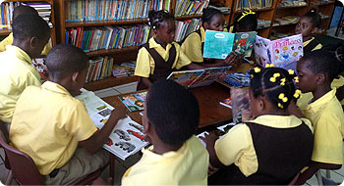
Practical Ideas: Students can pull out a book during…
Classroom interruptions.
Bell ringers and warm-ups.
When students are done.
In between times (sports days, awards days, assemblies) – how to keep your students quiet while they wait.
Library Time (waiting for other students).
Notes:
*Other practical ideas outside of the Language block include having students pull out a book during classroom interruptions—when a teacher is asked a question by an administrator or has to pause the lesson for whatever reason. Also students can be trained to get out their book to read at the very beginning of the school day while they are waiting for class to begin or for their teacher to arrive. Perhaps the routine could be that as soon as the students come in from recess, that the class reads for 15 minutes quietly. When students finish assignments, students can get out their book to read—that way you don’t have to create additional work for the “early finishers.” In between times like sports days, awards days, and assemblies—students can keep quiet while they are waiting by pulling out their book to read and then putting it away once the assembly starts. And of course Library Time. Once students have checked their books in and out, Library Time should be used for actually getting a jump start on reading their new book for the week!

Slide 16
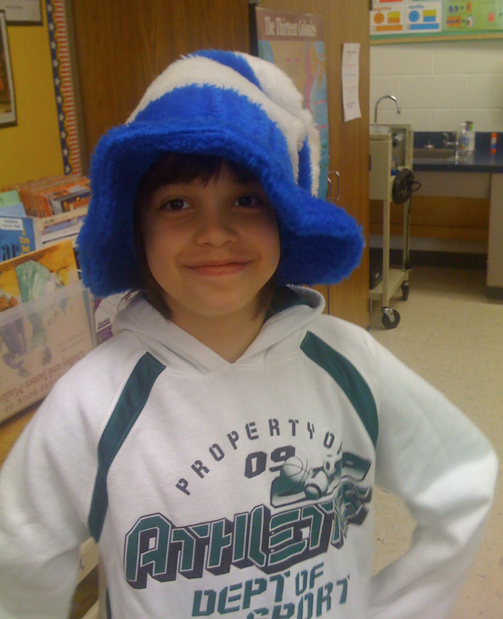
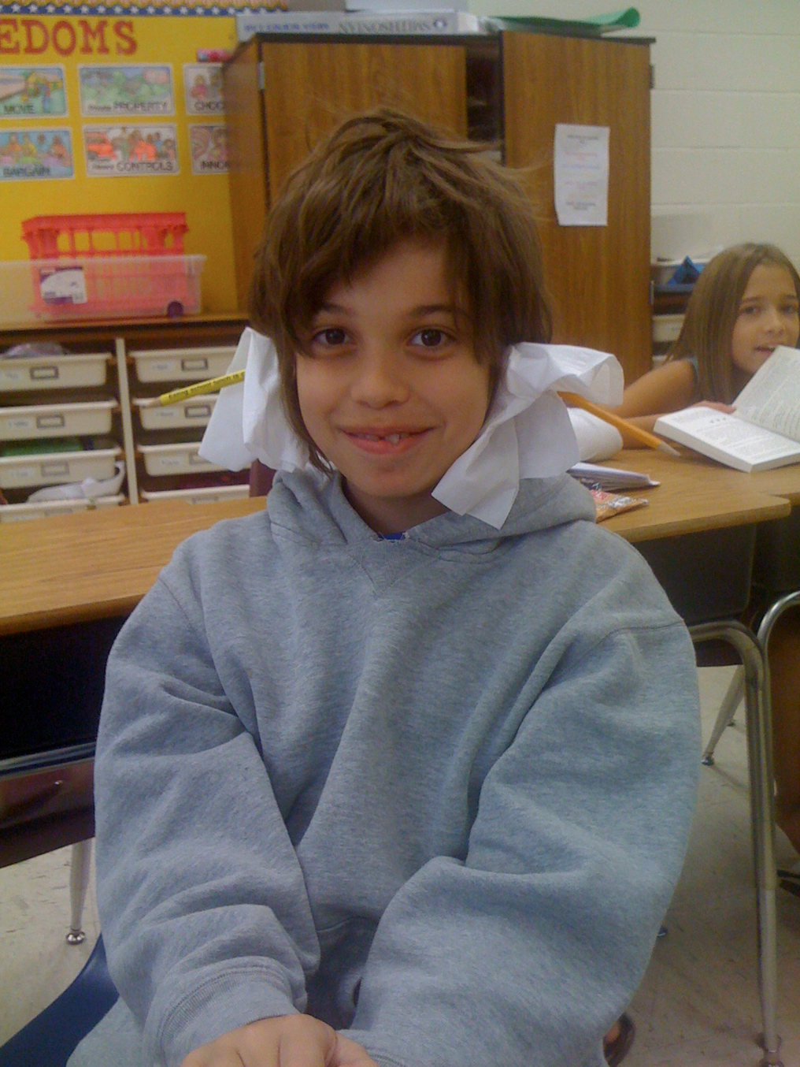
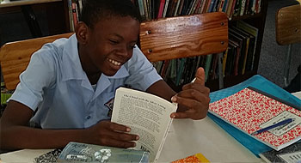
How to motivate reluctant readers?
Read a chapter book aloud to your students and stop halfway through.
Share book recommendations.
Find out what topics interests your students to assist in students finding books they may want to read.
Notes:
*We all have those students who are reluctant to read. They are convinced they don’t like to read or they’re not a strong reader or they don’t think it is cool. How do we as teachers work to change this?
A few ideas I can share with you. Read a page or two of a chapter book aloud to your students each day—perhaps right after recess or lunch while your students are settling in. And then stop—halfway through. You can also do this with picture books. Often times, students are so curious about what happens next in the book—that they are motivated to pick it up and read what happens themselves. Or they will want to read other books like it or the next book of the series. Reading books aloud is a great way to generate interest and give reluctant readers an opportunity to enjoy books—by listening—before they begin enjoying reading on their own.
Like I have mentioned before, share book recommendations with your students. When you have read a book in the library—and then you recommend it to a student, because you ACTUALLY think they are going to like it, that gesture will speak volumes to that student. They KNOW you know what you are talking about. You’ve read the book. You care about the student. You are just connecting the dots.
If you don’t know your students and what interests them—start asking questions like I have shared before. Get to know them. Walk with them. Sit with them. Converse with them. They want to feel loved and belong. They want to know that their teacher really cares about them. When you know your students—you can point them to books that they will like. You can show them book series in the library that you know they will think are funny or interesting.
*I had a student named Hank who didn’t like to read. He had such trouble picking out a book and then actually reading the book. He abandoned a lot of books. It wasn’t until I took the time to understand who he was and what he liked and what he wanted to do—that I was finally able to show him a book that he WANTED to read—that he did not want to put down. *He loved humor! He wanted books that were going to make him laugh out loud. He wanted silly and goofy. And as soon as I opened this door to him through books and reading—he was eating these books up. So much so—that he read every single funny book that existed in our school library. He actually ran out books to read of this type and guess what he did?! He started writing his own! He modeled his own funny books after the books that had made him laugh so hard in the library.

Slide 17


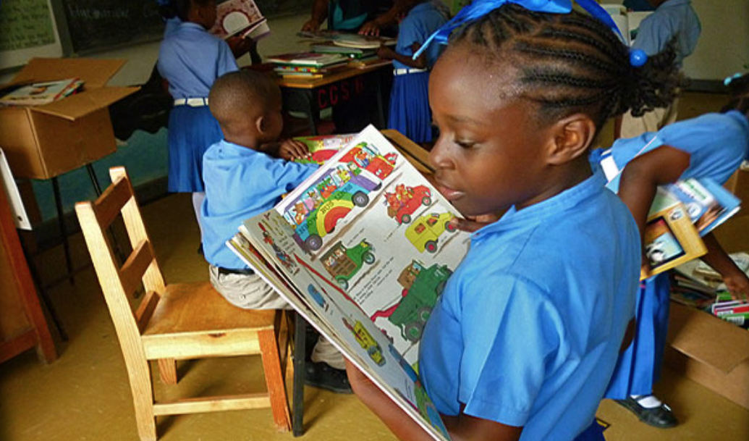
Motivating students to read-for-pleasure
Allow students to choose graphic novels and comics.
Allow students to abandon a book and choose another if it does not appeal to them.
Withhold the book report requirement and implement a “Reader’s Notebook” or other method of accountability.
Provide places around our classroom(s)/school for students to read.
Notes:
As teachers, it is our job to motivate students to read for pleasure—or they won’t do it on their own. Few of the homes they live in—model reading and encourage reading. It’s not because our students’ parents are bad; it is because they don’t know any better either! They are in many ways—first generation pleasure readers! And it’s going to change their lives.
Allow students to choose graphic novels and comics. This past year, Hands Across the Sea sent a book called Superman Science: The Real-World Science Behind Superman’s Powers. Now look, we all know superman is a made-up character with made-up powers, but this very exciting graphic novel explores how real-life science and engineering relates to the Superman’s famous powers―and the real-world connections that students who love superheroes will learn through reading this book!
Allow students to abandon a book and choose another if it does not appeal to them. I had a student who tried to read a classic book called The Adventures of Tom Sawyer and Huckleberry Finn—maybe some of you know of it. Anyway, this book has a lot of dialect in it—and for a young kid who is only 10—that was extremely challenging for him. It took him 4 days to get through 10 pages. And you know what? We talked about it—him and me—and we decided it wasn’t the best book for him. So he put it back on the shelf and chose something else. It was an easier book, and it was one he could read well, understand what was going on in the story, and actually finish the book—which was a huge accomplishment. *If you haven’t heard of Big Nate, check it out! My boys love it!
Withhold the book report requirement and implement a “Reader’s Notebook” or other method of accountability. I recognize that the 6th grade exam requires a book report. But we can prepare students for that exam by getting them to read, read, read! And then to break apart the “book report” into smaller, manageable chunks through their journal prompts in their reader’s notebooks, so that when it is time to start piecing together the elements of a longer book report, it’s not a scary daunting task. They’re familiar with it. Writing about what they are reading is almost natural, because they are doing it most every day within our classes.
Finally, provide places around your classroom or your school for students to read. Students don’t just want to sit in their desks to read. So many of my students were so excited about the freedom to sit on the floor or sit under their desk, or sit outside against a wall, or at a picnic table to read. This made them excited for reading time, because it was something different for them to look forward to! I set the standards high about what I required of my students during reading time—no talking at all (unless to me), reading or writing about the book, and being mindful and respectful of the other students reading in our class too. But I always give them the freedom to read where they want to read, because it was a special privilege that got them even more motivated for our daily reading time!

Slide 18
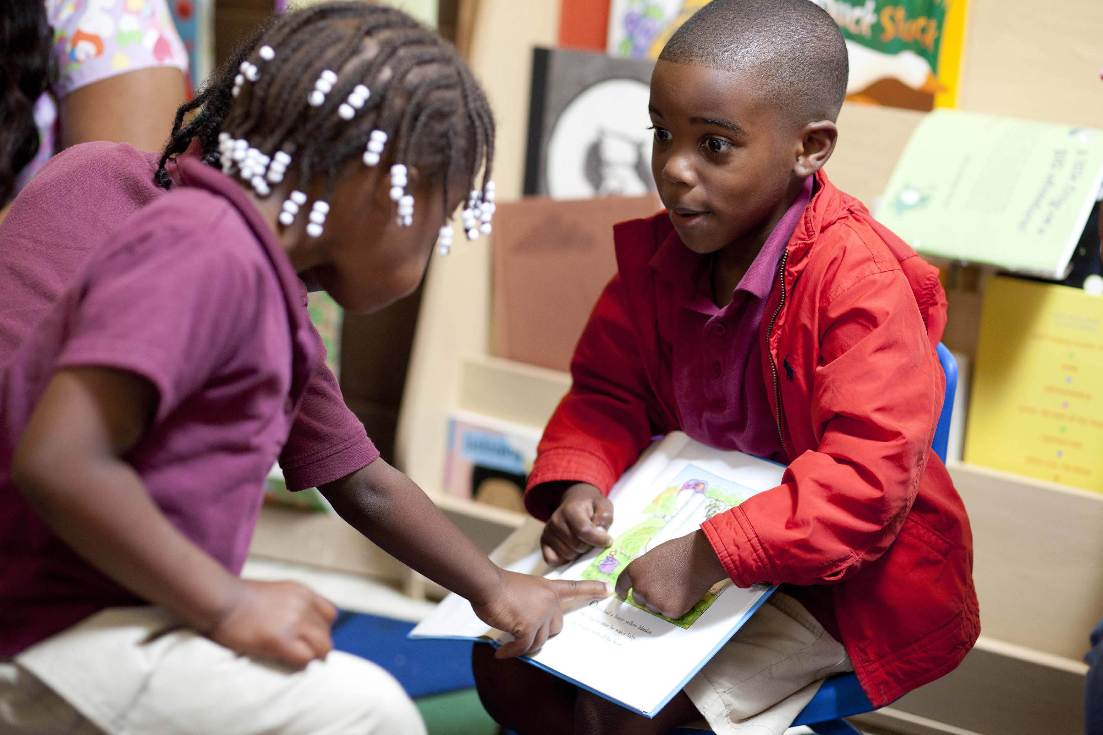
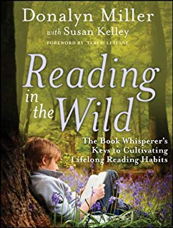
Provide opportunities for students to talk about books.
Research shows that it is important for students to share about what they are reading with others to solidify themselves as readers and to remember what they read.
Provide opportunities to share with partners (or reading club groups) and with the class.
Check in with your students individually and in groups.
Notes:
Provide opportunities for students to TALK about books. We discussed this earlier in our workshop, but the truth is when we read, we want to tell other people about what we are reading. Research shows that when we talk about books and what we just read, we retain it—we remember it for longer. We also use parts of our brain that help us better understand what we read WHEN we talk about it right after!
Research also shows that it is important for our students to share about what they are reading with others to solidify THEMSELVES as readers. They identify as a reader. Some of them for the very first time in their life. When they get to talk about books with others, they are the experts of the book they are reading! This gives our students confidence. Huge—especially for those reluctant readers.
This also helps our students become better writers. What? Yes, I said it. Better writers. When readers realize that they are members of the ’literacy club,’ a group of people who read and write, they ‘read like writers’ and absorb the enormous amounts of knowledge that writers possess. That’s why my student Hank didn’t even blink about writing a funny book himself! It was a no brainer to him. This kid, who barely read when I met him—had this surge of confidence to write a 15-page book himself after reading 20-some odd books that had made him laugh. He thought to himself, “Hey, I want to write a funny book. So I’ve got this crazy idea and story in my head. I am going to put it into words and write it, so that I can make other people laugh too.”

Slide 19
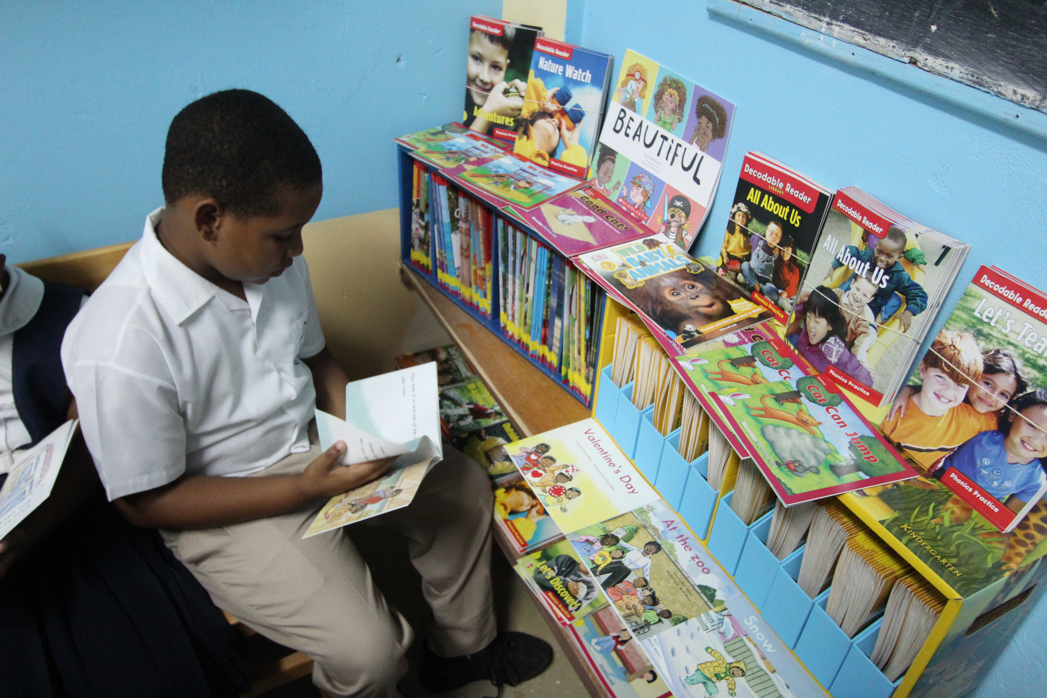
How can we make more time for independent reading?
How can we NOT?
Teachers need to be assured that creating such an environment will make your job easier, not harder, and will give more satisfying results.
Notes:
I come across so many teachers who say to me, “I just don’t have time in my school day to let my students read the books they want to read, because I have too much curriculum content to cover.” Look. I get it. I am a teacher too. But you want to know something? A lot of that curriculum, especially the Language Arts curriculum, WILL be taught, covered, practiced, and mastered, BECAUSE we are giving students the time to read in our classrooms.
We want to know what is wrong with our students’ reading abilities and their motivation to read and the scores on their reading tests. And yet, we keep giving them worksheets. Worksheet to teach phonics. Worksheet to teach punctuation. Worksheet to teach inferencing. Worksheet to teach prediction. Worksheet to teach summarization. You guys, we’ve got it backwards. We cannot teach these skills in isolation.
The ONLY way students will know how to confidently apply these skills is if they are reading a book and applying it to their reading OF THAT book! Students will naturally want to sound out those words on the page, because they WANT to know what the words say to better understand the story or the comic they are reading. Students will recognize and be familiar with correct punctuation, because they are watching it and reading it and using it as a reader all the time on the pages of the books that they read. Students will naturally infer when authors cleverly drop hints about what is happening in the story without explicitly saying it. Students will naturally predict and WANT to predict what will happen next or how the story will end, because they are into it! Students will want to naturally summarize the story—because they can’t wait to tell their friends about the crazy story they just read!
Teachers, we need to be assured that creating such an environment WILL make our job easier, not harder, and WILL give more satisfying results.

Slide 20

Pleasure reading is NOT something extra.
Reinforces the reading strategies and curriculum content that you are already teaching.
Reading curriculum K-6 and ENG Forms 1-5 curriculum
“We have confused cause and effect. We have assumed that we first master language ‘skills’ and then apply these skills to reading and writing. Rather, reading for meaning, reading about things that matter to us, is the cause of literate language development.” –Dr. Krashen
Notes:
Pleasure reading is NOT something extra to add to our school day. It is the foundation of our school day. We can build upon the reading time in our classroom with everything else that we teach. Pleasure reading reinforces the reading strategies and curriculum content that you are already teaching. Reading curriculum K through 6 and English Forms 1 through 5 curriculum is all supported by letting our students read books they want to read!
We have confused cause and effect. We have assumed that we first master language “skills” and then apply these skills to reading and writing. Rather, reading for meaning, reading about things that matter to us, is the cause of literate language development. What that means is that we cannot keep teaching our students skills and expecting them to become masters of these skills with worksheets and copying down sentences from the board. This is not working. This has not worked. It will not work in the future. We have to give our students a reason to learn these skills. The reason is—they get to apply them to reading. And not reading worksheet passages that we have photocopied. We are talking about reading books they are thrilled to find in the library, read in our classrooms, and take home to read at night.

Slide 21

How principals and education officers can support.
Implement and enforce school-wide DEAR time (or extend).
Implement, encourage, and monitor that all teachers take their students to the school library once a week.
Support teachers in protecting “pleasure reading time” within their Language blocks.
Support teachers in lesson planning to integrate curriculum standards into “mini lessons” to condense direct instruction, freeing up more time to practice those reading strategies through pleasure reading.
Share the library with parents and the community through volunteer opportunities, events, school Facebook page, etc.
Encourage ”teachers as readers” book clubs, etc.
Notes:
Principals and Education Officers watching this! You can support us too! Implement and enforce school-wide DEAR time (or extend it to 30 minutes) every day. Implement, encourage, and monitor that all teachers take their students to the school library once a week. Check your borrowing record charts! Is lending increasing at your school? Are more students and teacher checking out books from your library every week? Which grades are doing the best at your school? Why is that so? How can we encourage other grades to get to the library more often and to motivate their students to read more books too?
Support teachers in protecting “pleasure reading time” within their Language blocks.
Support teachers in lesson planning to integrate curriculum standards into “mini lessons” and condense direct instruction, freeing up more time to practice those reading strategies through pleasure reading. You know it can be done. Remind your teachers that it can be. Model it for them. Show them. Encourage them!
Share the library with parents and the community through volunteer opportunities, events, your school Facebook page, etc.
Encourage “teachers as readers” book clubs, etc. Join one yourself! Sit with your teachers once a month during the lunch break to talk about the books that all of you are reading. Share those books. Read them on the bus while you are waiting to get home from school. Read books from your library to your own children at night. You set the reading culture of your school. You are a vital asset to the success of your school’s library and your school’s overall reading success! Be the change you want to see!

